Slide 1

Beamforming Application Using RFSoc 4x2 Board
Participants:
Berke Kaan Cetinkaya
Ilkay Kerim Özküney

Slide 2
Introduction
Working Principle
Setup
Achieved Results
Possible Improvements
Summary

Slide 3
Working Principle
Transmitting and Receiving 433MHz Signals
Transmitting Side
Receiver Side
RFSOC
2 Dipole Antennas
1 Dipole Antenna
Bandpass Filter
RFSOC
1. Transmitting 433Mhz signals through 2 antenna phase array.
2. Detecting the amplitude of signals based on the radiation pattern of the phased array

Slide 4
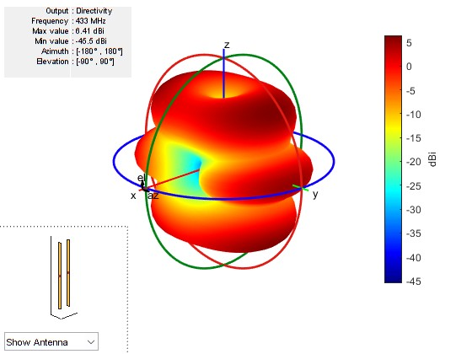
Radiation Pattern
The Radiation Pattern of the Phased Array With One Half-Wavelength Space Between Them (0.39m)
Matlab Simulation

Slide 5
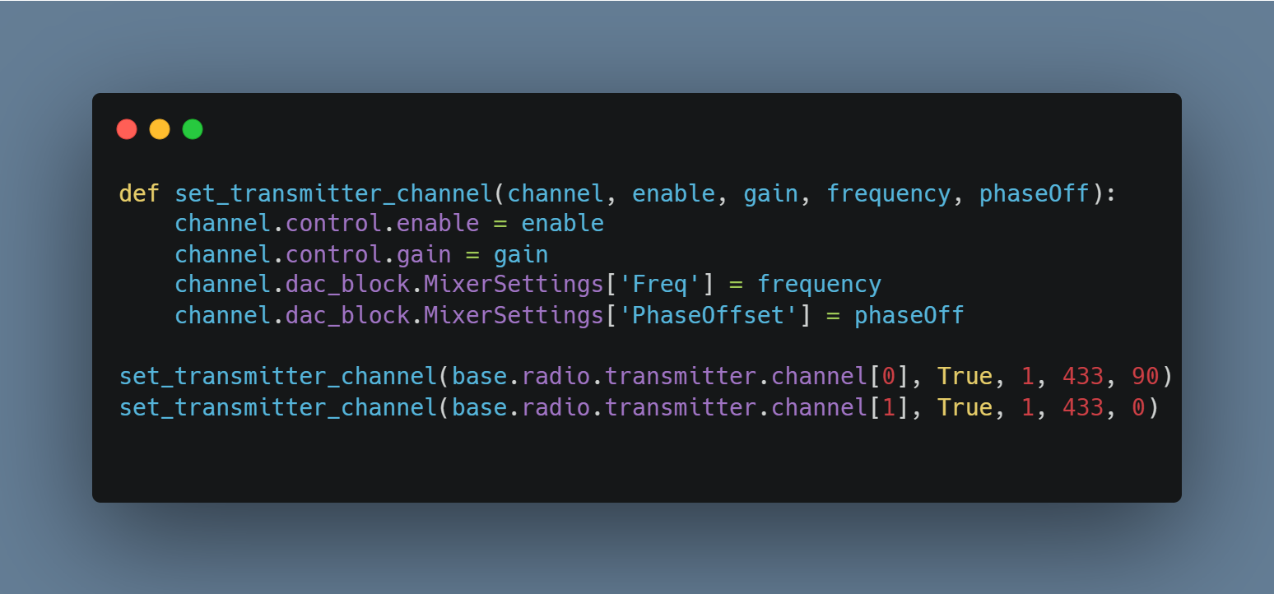
Transmitting
Function to set up DAC channels
Setting up available DAC Ports and transmitting signals

Slide 6
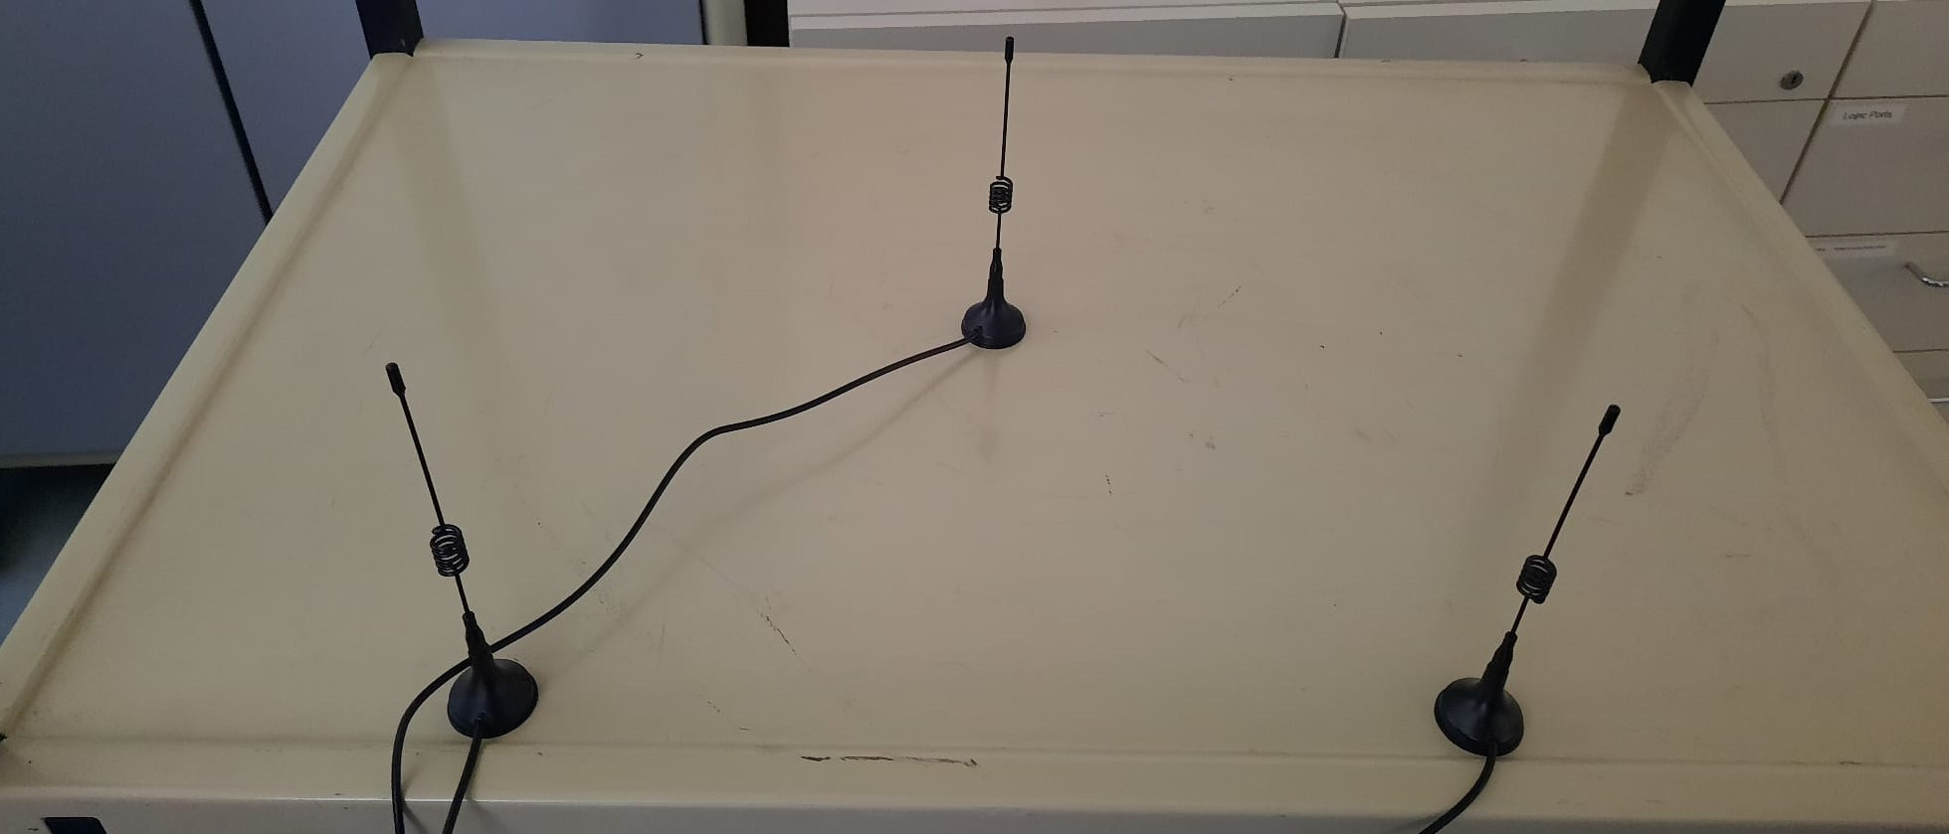
Setup
Receiving Antenna
Transmitting Antenna 1
Transmitting Antenna 2

Slide 7
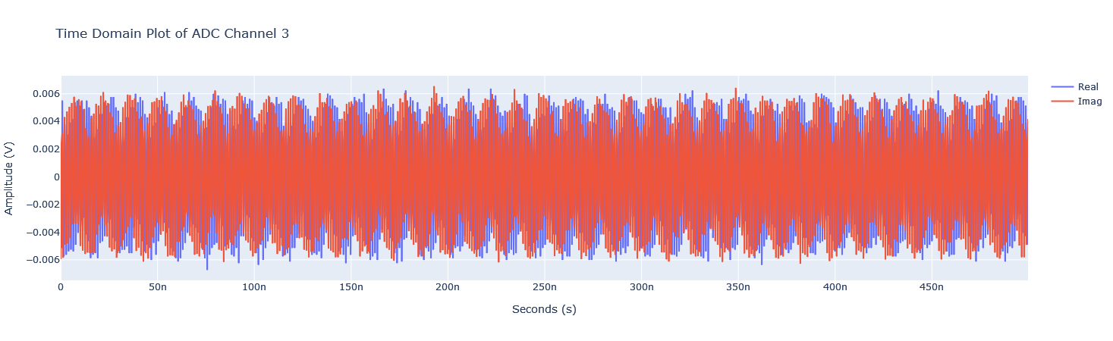
First Test (No phase shift)
As can be seen below, antenna receives “a” signal.

Slide 8
Performing FFT
At this point, we have no idea if our signal is coming from our transmitter signals or if it is capturing signals from the environment.
So, we performed FFT to see the signal in the frequency spectrum.

Slide 9
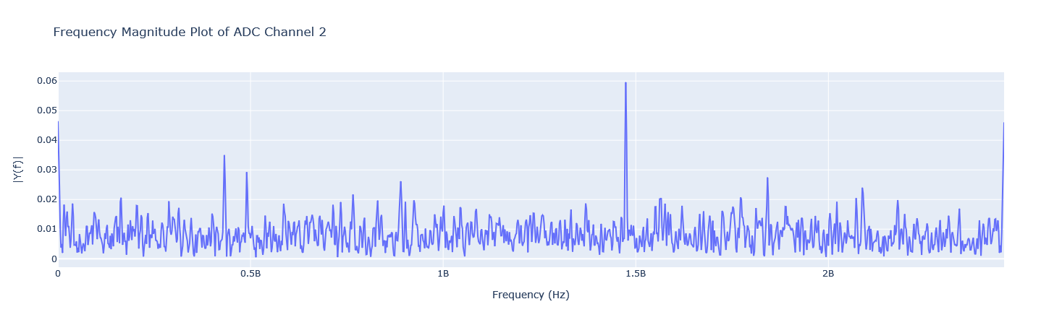
Frequency Spectrum
Noise in 1.3GHz range
Our Signal

Slide 10
To Get Rid Of The Noise
Before moving on with applying a phase shift, we need to get rid of the noise as much as possible.
Solution: Designing and building a bandpass filter that will operate in 400 – 450MHz range.

Slide 11
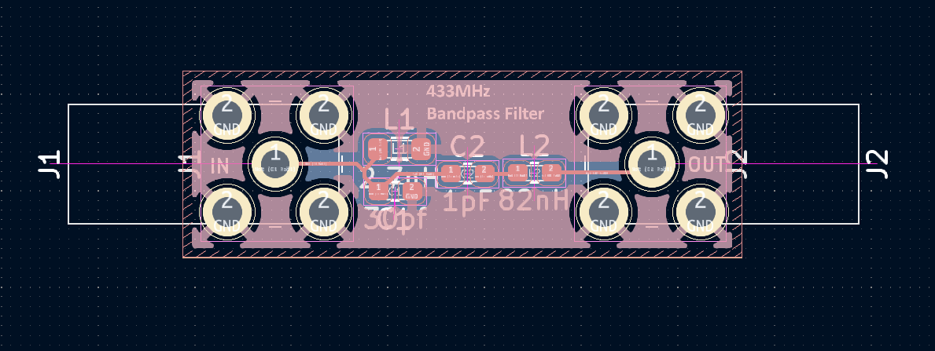
Bandpass Filter
We carefully designed and built the filter, paying attention to the fact that we need to maintain 50 ohm impedance, since our antennas have a 50 ohm impedance. Any impedance mismatch will affect the strength of the signals.

Slide 12
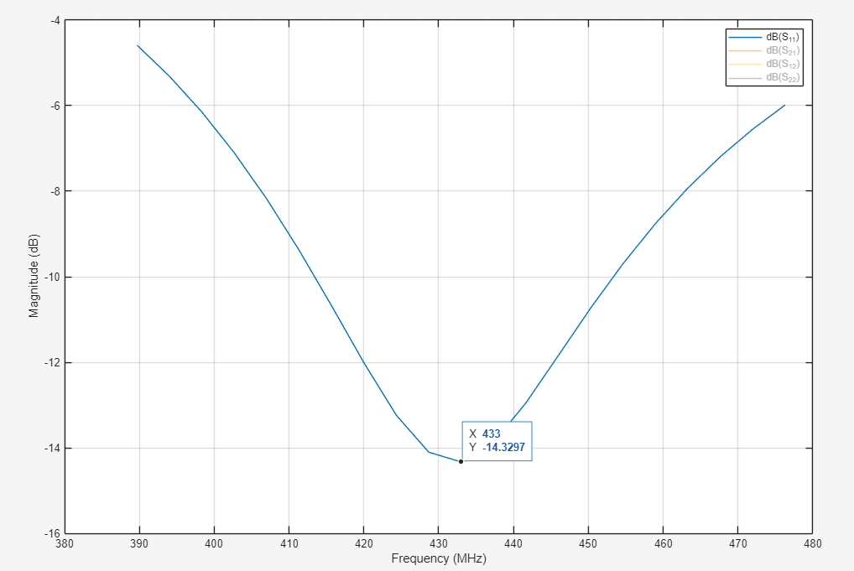
S11 Parameter of The Bandpass Filter

Slide 13
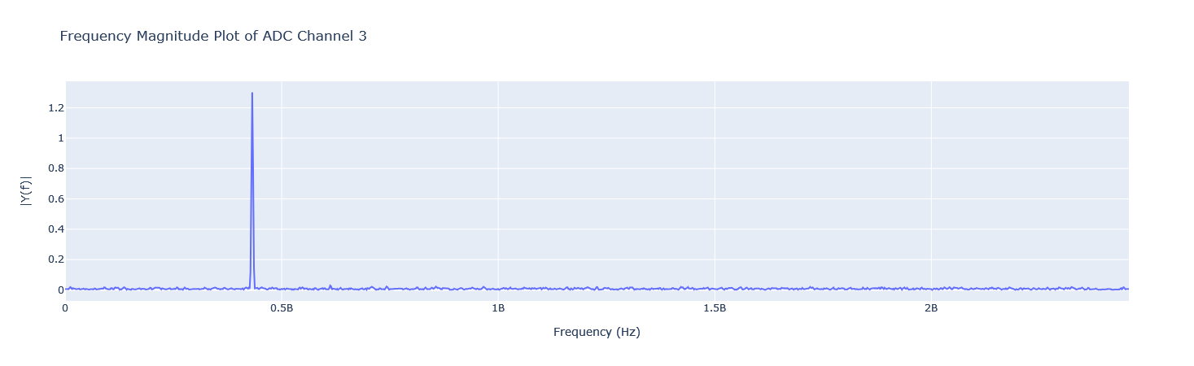
Testing The System With The Bandpass Filter
Our Signal (433MHz)

Slide 14
Beamforming
Now that we don’t need to worry about the noise anymore, we can start testing the beamforming capabilities of our system

Slide 15
Expected Results
According to the MATLAB simulations, we need to get stronger signals when we apply a phase shift to the second antenna to get constructive interference.

Slide 16
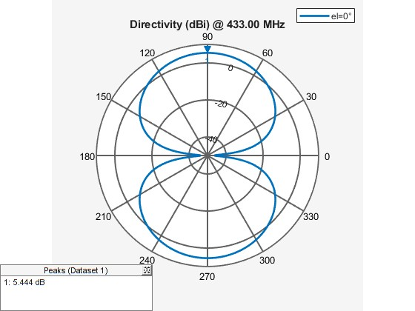
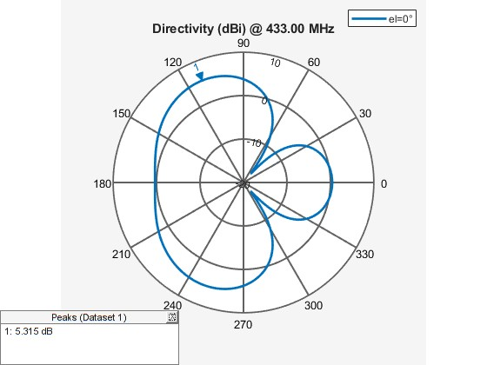
Azimuth Patterns of The Setup at 0,90,180 Degrees

Slide 17
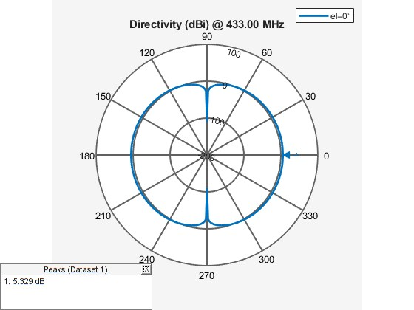
Azimuth Patterns of The Setup at 0,90,180 Degrees

Slide 18
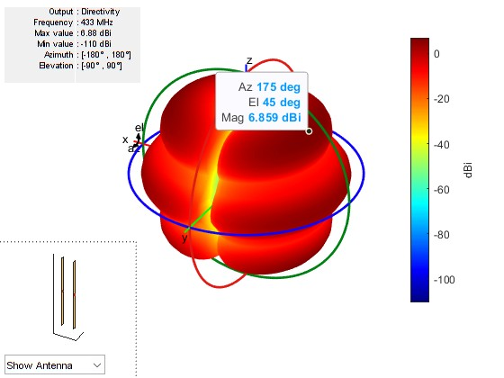
3D Radiation Pattern at 180 Degree Phase Shift

Slide 19
0 Degree Phase Shift

Slide 20
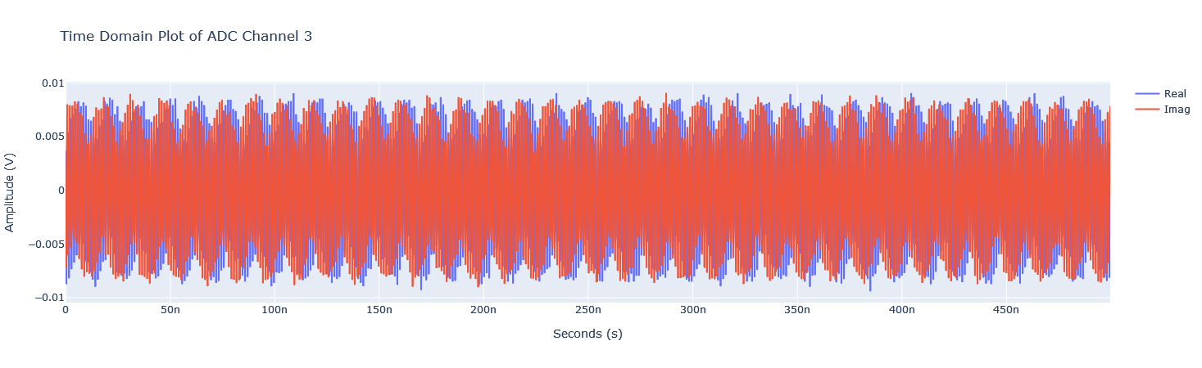
90 Degree Phase Shift

Slide 21
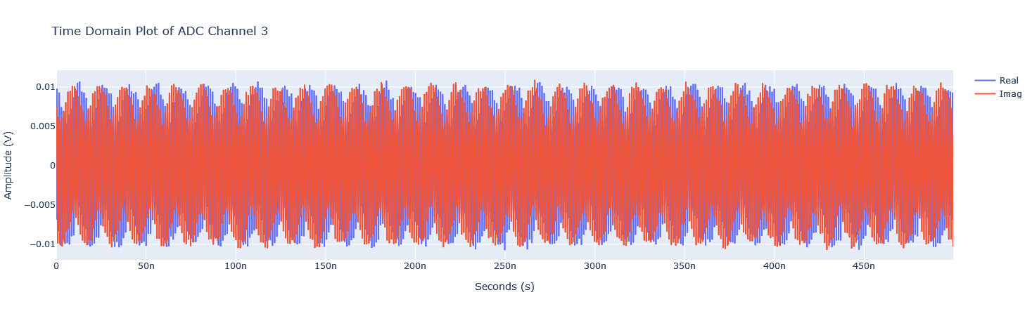
180 Degree Phase Shift

Slide 22
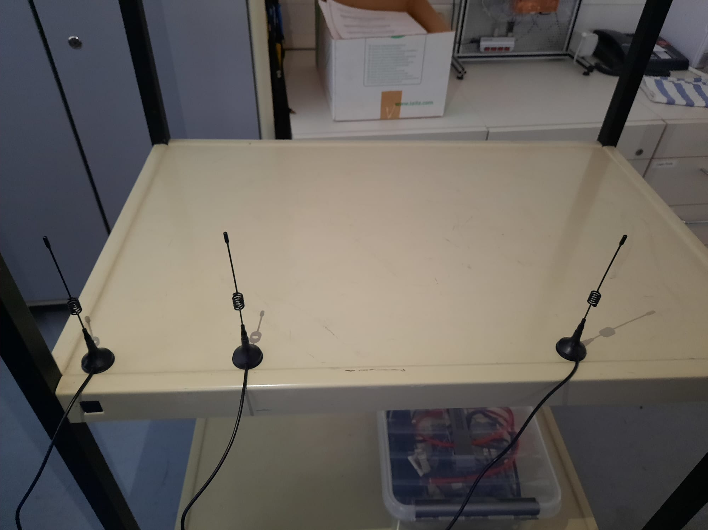
180 Degree Phase Shift
Receiving Antenna

Slide 23
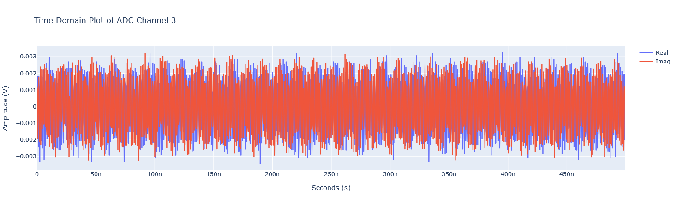
180 Degree Phase Shift

Slide 24
Possible Improvements
A Yagi-Uda antenna could be used as a receiving antenna for better detection.
Enlarging the phased array, like adding two or more dipole antennas could allow us the achieve more directivity, but unfortunately this is not possible with the RFSoC 4x2 board since we only have 2 DAC ports available.

Slide 25
Conclusion
In this project we have demonstrated:
Desinging and building a bandpass filter to use with the RFSoC board.
The beamforming capabilities of the RFSoC 4x2 board by forming a phased array consisting of dipole antennas and by applying phase shift to get constructive interference in the desired direction.
Detecting and analyzing the received signal

Slide 26
THANK YOU FOR LISTENING

